Slide 1


Using Semantics of Textbook Highlights to Predict Student Comprehension and Knowledge Retention
David Y.J. Kim
Tyler R. Scott, Debshila Basu Mallick, and Michael C. Mozer
Notes:
Good Morning/Afternoon everyone, thank you for joining my presentation.
The work I’ll present is with my co-authors Tyler, Debshila, and Mike.

Slide 2

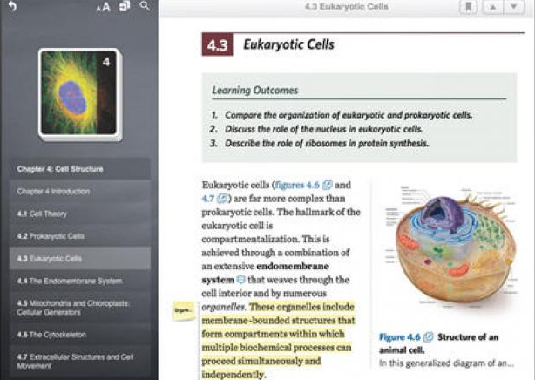
Motivation
With adoption of digital textbooks, we have the opportunity to observe students as they first engage with material.
Observations include highlights, gaze, scrolling patterns, etc.
Can these observations be useful for predicting comprehension and knowledge retention?
https://www.wan-ifra.org/articles/2013/08/19/more-people-are-reading-the-morning-paper-the-night-before
Notes:
The traditional way of evaluating students’ understanding of textbook material is through testing.
But with the adoption of digital textbooks, we have the opportunity to observe students
as they first engage with material.
Our research analyzes electronic highlights – virtual yellow marks that students can make in their digital
textbooks.
But of course other observations are possible, including gaze, scrolling patterns, and page advances.
We are interested in whether these observation can be useful for predicting comprehension
and knowledge retention.

Slide 3

Past Research
Winchell et al. (2020)
30-minute Mechanical Turk experiment
Use highlight pattern to predict accuracy on individual quiz questions
Waters et al. (2020)
Data from OpenStax (authentic learning environment)
Did highlighting a sentence in the text improve memory for that sentence?
Kim et al. (2020)
Data from OpenStax
Use highlight pattern to predict overall quiz accuracy
Notes:
Our group has done past work exploring highlighting.
The first paper involves a controlled experiment, and the second 2 papers examine data from an authentic learning environment, OpenStax.
OpenStax is an open-access textbook platform that has been adopted for use in high school and college courses.
It now includes a facility to allow students to highlight their virtual textbooks and it administers review quizzes.
The first two papers looked at student performance on specific quiz questions.
The work we presented last year at this workshop looked at overall quiz accuracy.

Slide 4
Limitations of past research
All models used a positional encoding of highlights
E.g., sentences 14, 27, and 36 were highlighted
E.g., words 19-25, 45-60, and 191-212 were highlighted
To overcome
Use semantic encoding
Concern about the nature of information that highlights provide
Perhaps students who highlight score better because generally they are more motivated, not because specific highlights reflect better understanding
To overcome
Incorporate latent factor representing a student’s ability (as in item-response theory)
Notes:
[david, I assume you see the ordering of the paragraphs. I suggest using ‘item response theory’ since it’s more general than ‘rasch model’]

Slide 5
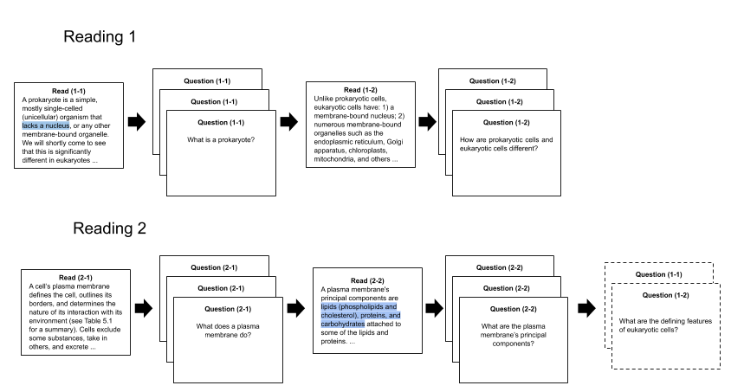
Data (OpenStax 2019)
Group | #
Students | 11,134
Sections | 897
Student-Sections | 830,320
Student-Sections With Highlights | 27,019
Waters et al.(2020)

Slide 6
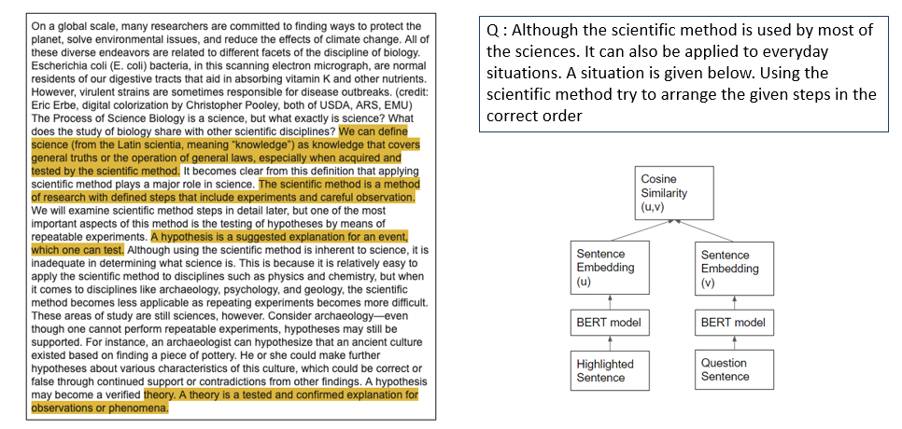
Q. What is semantic information in highlights?
On a global scale, many researchers are committed to finding ways to protect the planet, solve environmental issues, and reduce the effects of climate change. All of these diverse endeavors are related to different facets of the discipline of biology. Escherichia coli (E. coli) bacteria, in this scanning electron micrograph, are normal residents of our digestive tracts that aid in absorbing vitamin K and other nutrients. However, virulent strains are sometimes responsible for disease outbreaks. (credit: Eric Erbe, digital colorization by Christopher Pooley, both of USDA, ARS, EMU) The Process of Science Biology is a science, but what exactly is science? What does the study of biology share with other scientific disciplines? We can define science (from the Latin scientia, meaning “knowledge”) as knowledge that covers general truths or the operation of general laws, especially when acquired and tested by the scientific method. It becomes clear from this definition that applying scientific method plays a major role in science. The scientific method is a method of research with defined steps that include experiments and careful observation. We will examine scientific method steps in detail later, but one of the most important aspects of this method is the testing of hypotheses by means of repeatable experiments. A hypothesis is a suggested explanation for an event, which one can test. Although using the scientific method is inherent to science, it is inadequate in determining what science is. This is because it is relatively easy to apply the scientific method to disciplines such as physics and chemistry, but when it comes to disciplines like archaeology, psychology, and geology, the scientific method becomes less applicable as repeating experiments becomes more difficult. These areas of study are still sciences, however. Consider archaeology—even though one cannot perform repeatable experiments, hypotheses may still be supported. For instance, an archaeologist can hypothesize that an ancient culture existed based on finding a piece of pottery. He or she could make further hypotheses about various characteristics of this culture, which could be correct or false through continued support or contradictions from other findings. A hypothesis may become a verified theory. A theory is a tested and confirmed explanation for observations or phenomena.
Dark Yellow : less related to the question
Light Yellow : more related to the question

Slide 7
Framework for the semantic analysis
non- highlighted
sentence
non- highlighted
sentence
non- highlighted
sentence
highlighted
sentence
highlighted
sentence
highlighted
sentence

Slide 8
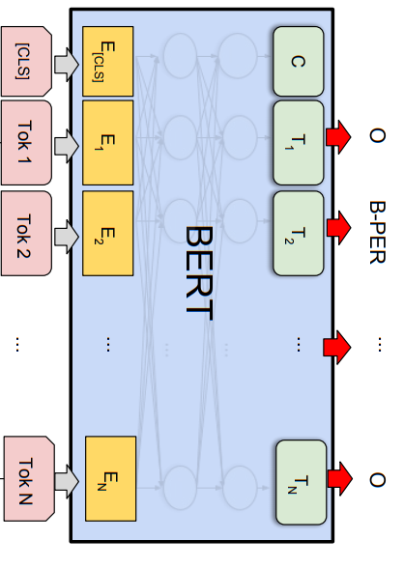
Framework for the semantic analysis
non- highlighted
sentence
non- highlighted
sentence
non- highlighted
sentence
S
highlighted
sentence
highlighted
sentence
highlighted
sentence
S

Slide 9
Framework for the semantic analysis
non- highlighted
sentence
non- highlighted
sentence
non- highlighted
sentence
S
highlighted
sentence
highlighted
sentence
c o m p a r i s o n
highlighted
sentence
match scores
S

Slide 10
Framework for the semantic analysis
correctness
prediction
non- highlighted
sentence
non- highlighted
sentence
non- highlighted
sentence
regression
model
S
highlighted
sentence
highlighted
sentence
c o m p a r i s o n
highlighted
sentence
match scores
S

Slide 11
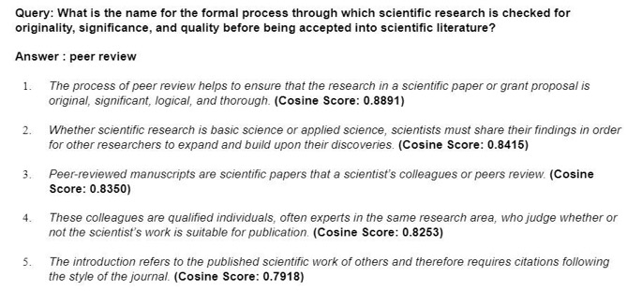
Which sentence of the text best matches the question according to SBERT?
Notes:
[I hope you aren’t planning to read the entire slide. Probably good to read just the query and the first sentence]

Slide 12
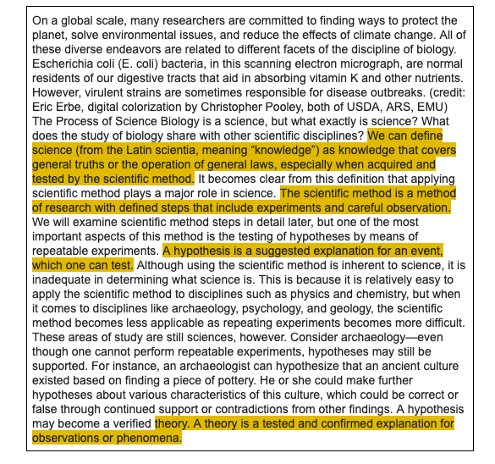
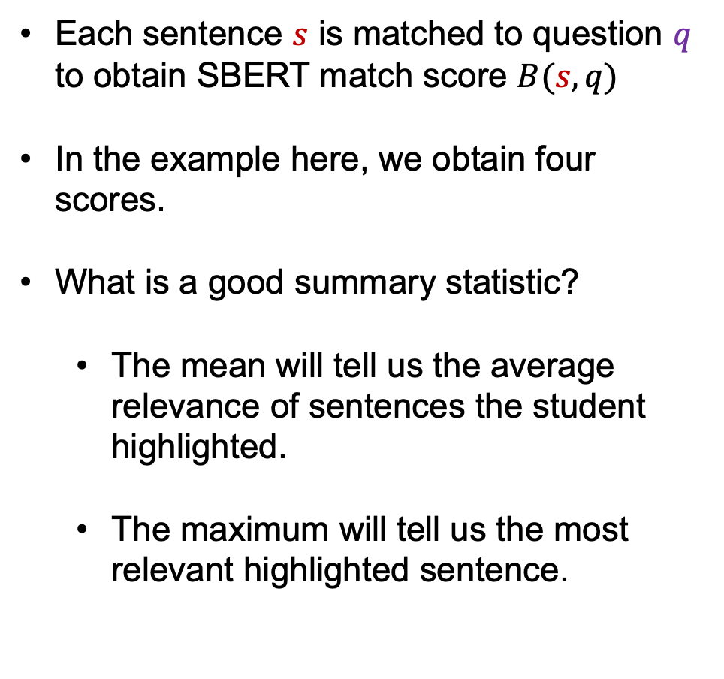
When multiple sentences are highlighted, how do we summarize the match scores?
Each sentence $s$ is matched to question $q$ to obtain SBERT match score $B(s,q)$
In the example here, we obtain four scores.
What is a good summary statistic?
The mean will tell us the average relevance of sentences the student highlighted.
The maximum will tell us the most relevant highlighted sentence.
1
2
3
4

Slide 13
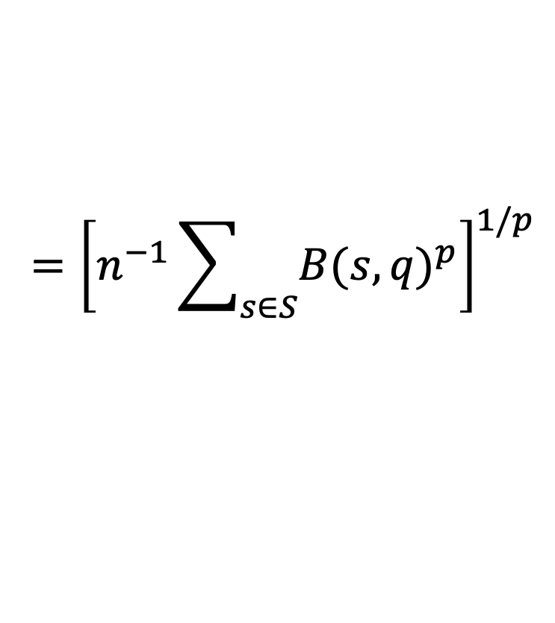

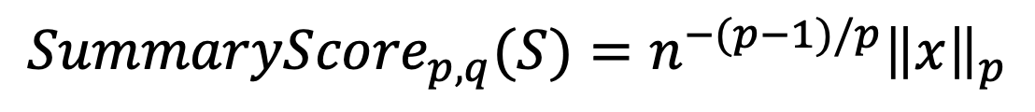



For a set of sentences $S=\left\{s_{1}, s_{2}, …, s_{n}\right\},$
if $x$ is the vector of BERT match scores between each sentence and question $q$,
$x=\left[B\left(s_{1},q\right) B\left(s_{2},q\right) …B\left(s_{n},q\right)\right]$
$$n^{−1}{\left\|x\right\|}_{1}$$
$${≤n}^{−1/2}{\left\|x\right\|}_{2}≤n^{−2/3}{\left\|x\right\|}_{3}≤⋯$$
$${\left\|x\right\|}_{∞}$$
mean
max
$$={\left[n^{−1}\sum_{s∈S}{{B(s,q)}^{p}}\right]}^{1/p}$$
$${Summary{Score}_{p,q}(S)=n}^{−(p−1)/p}{\left\|x\right\|}_{p}$$
Notes:
For a set of sentences S,
if x is the vector of BERT match scores between each sentence and question,
[advance] the mean is related to the L1 norm
[advance] the max is the L-infinity norm
[advance] and we have a whole family of norms that lie in between.
[advance] we can define a summary score for each norm p

Slide 14
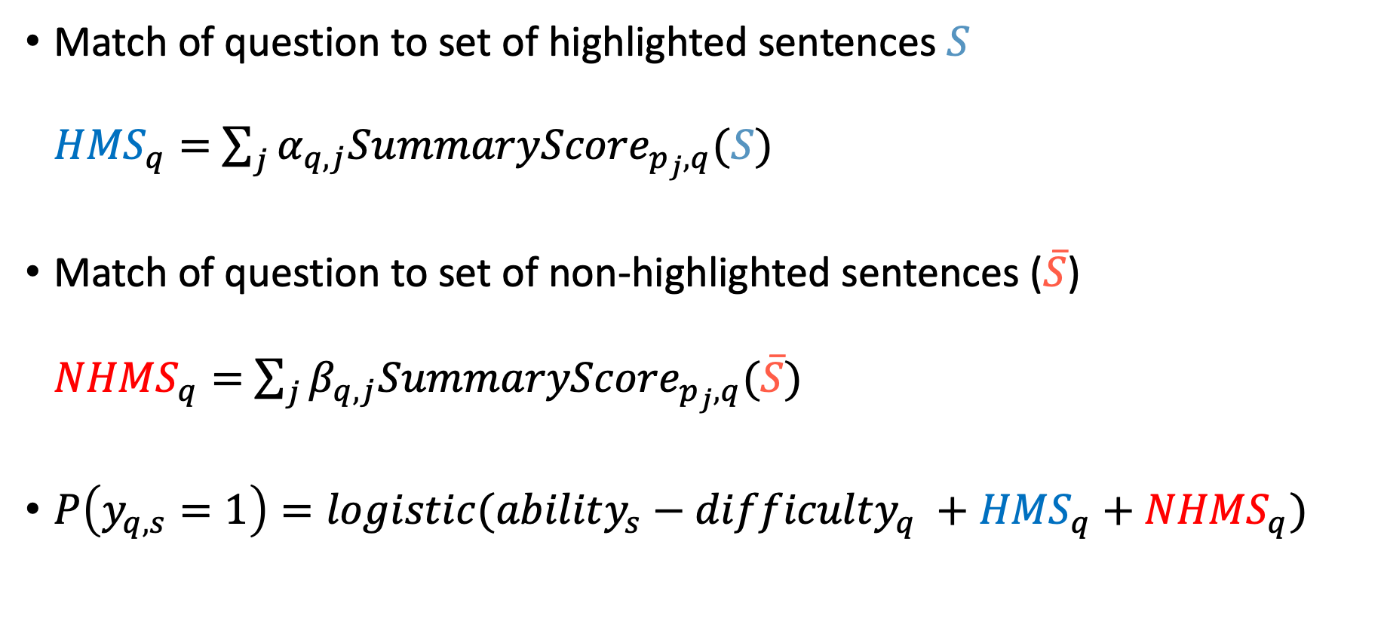
Match of question to set of highlighted sentences $S$
${HMS}_{q}=$ $\sum_{j}{{α_{q,j}SummaryScore}_{p_{j},q}(S)}$
Match of question to set of non-highlighted sentences ($\overline{S}$)
${NHMS}_{q}=$ $\sum_{j}{{β_{q,j}SummaryScore}_{p_{j},q}(\overline{S})}$
$P\left(y_{q,s}=1\right)=logistic(ability_{s}−difficulty_{q} +{HMS}_{q}+{NHMS}_{q})$
Notes:
[david, this slide reveals one bullet at a time]

Slide 15
Methodology
Model each section separately
Perform 5-fold cross validation on each section
train on 4 partitions of data
test on remaining
repeat 5 times
Two evaluation measures, each with some advantages
AUC – area under the ROC curve
PRC – precision recall curve

Slide 16
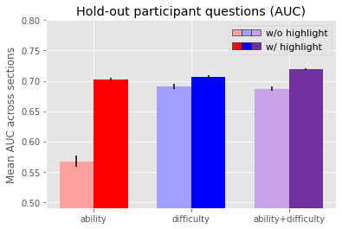
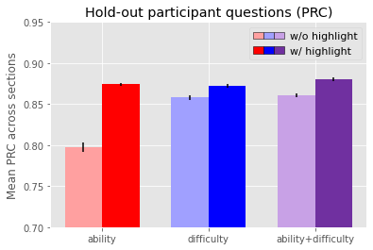
Cross validation on {student, question} pairs
Notes:
This graph shows the mean AUC across sections for models with 6 different subsets of features.
The darker colored bars include highlighting features; the lighter bars do not.
The red bars include a feature for student ability,
blue bars include a feature for question difficulty,
and purple bars include both.
You can see in all cases that adding highlighting features improves model accuracy.
Also important here, highlighting information improves models that are based on student ability.
This tells us that highilghting is providing useful insights beyond indicating a student’s average ability level;
it is telling us about how a student will perform relatively on a specific question.
[expose PRC curve]
here’s the same graph for PRC instead of AUC.
All results for AUC are also found for PRC as the measure.

Slide 17
Cross validation on held out students

Slide 18
Cross validation on held out questions

Slide 19
Highlighting improves predictions across levels of the Bloom taxonomy
recall understand synthesize
apply evaluate
create
recall understand synthesize
apply evaluate
create

Slide 20
Comparing positional and semantic representations of highlights
baseline
positional
highlight
features
semantic
highlight
features
baseline
positional
highlight
features
semantic
highlight
features

Slide 21
Conclusions
We explored the relationship between student highlighting patterns and question-answering performance using an encoding of highlights based on deep neural net embeddings of text and question content.
Augmenting a baseline model with highlighting features improves predictions of whether a student will answer a specific question correctly.
This improvement is found for held out student-question pairs and held out students, but not held out questions.
Our models predict well for across all levels of the Bloom Taxonomy (conceptual difficulty)
We found that the semantic encoding of highlights is superior to a positional encoding.
We haven’t yet looked at the combination but are anxious to do so!
Notes:
YOU WILL BE ASKED WHY NOT HELD OUT QUESTIONS

Slide 22
Questions

Slide 23
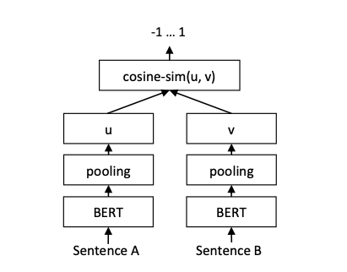
Q. How can we capture the semantic encoding?
BERT is a pre-trained transformer network that has produced numerous state-of-the-art results in various NLP tasks
Sentence-BERT (SBERT) is a modification of the pre-trained BERT network that derive semantically meaningful sentence embeddings that can be compared using cosine-similarity

Slide 24
Future Work
Explore several methodological decisions
Whether the correct decomposition of highlights is at the level of sentences
Build section-free model
Combine semantic and positional information into one model
Notes:
personally, I would leave out this future work. there’s not a lot of content and I put the one interesting bullet (the combined model) on the previous slide.

Slide 25
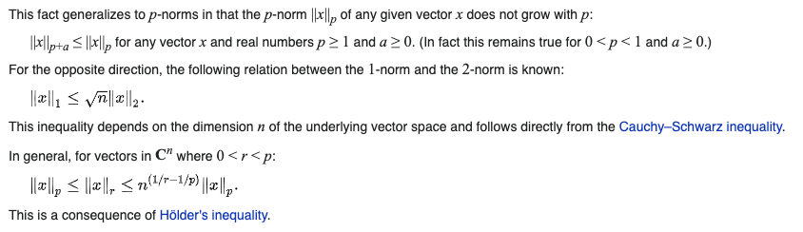
Investigating L^{p} space
From Wikipedia “https://en.wikipedia.org/wiki/Lp_space”

Slide 26
Investigating L^{p} space
From Wikipedia “https://en.wikipedia.org/wiki/Lp_space”

Slide 27
Cross validation on {student, question} pairs
Notes:
I don’t think you need to draw the white arrows (which are hard to see) to convince anyone that there’s an improvement. I’d suggest dropping this slide and using some sort of description as I wrote out on the previous slide. it’s easy to compare the dark and light bars and see the dark bars are taller.

Slide 28
Investigating L^{p} space
From Wikipedia “https://en.wikipedia.org/wiki/Lp_space”
${|\left|x\right||}_{1}≤\sqrt{n}{\left|\left|x\right|\right|}_{2}≤\sqrt[3]{n^{2}}{\left|\left|x\right|\right|}_{3}≤…≤n{\left|\left|x\right|\right|}_{∞}…(1)$

Slide 29
Problems with multiple BERT scores
Students may highlight multiple segments, and these multiple highlights produce multiple BERT scores B(s,q)
In the case on the left we would get, 4 B(s,q)
Need to figure out a sensible way to combine these numbers
The maximum will tell us the most relevant segment the student attended to whereas the average will tell us the average relevance of segments
1
2
3
4

Slide 30
Investigating L^{p} space
From Wikipedia “https://en.wikipedia.org/wiki/Lp_space”
${|\left|x\right||}_{1}≤\sqrt{n}{\left|\left|x\right|\right|}_{2}≤\sqrt[3]{n^{2}}{\left|\left|x\right|\right|}_{3}≤…≤n{\left|\left|x\right|\right|}_{∞}…(1)$
In equation (2) the left side($\frac{1}{n}{|\left|x\right||}_{1}$) is the mean, and the right side(${\left|\left|x\right|\right|}_{∞}$) is the max. Anything between them means something in the middle of the two.
$$\frac{1}{n}{|\left|x\right||}_{1}≤\frac{\sqrt{n}}{n}{\left|\left|x\right|\right|}_{2}≤\frac{\sqrt[3]{n^{2}}}{n}{\left|\left|x\right|\right|}_{3}≤…≤{\left|\left|x\right|\right|}_{∞}…(2)$$

Slide 31
Investigating L^{p} space
From Wikipedia “https://en.wikipedia.org/wiki/Lp_space”
${|\left|x\right||}_{1}≤\sqrt{n}{\left|\left|x\right|\right|}_{2}≤\sqrt[3]{n^{2}}{\left|\left|x\right|\right|}_{3}≤…≤n{\left|\left|x\right|\right|}_{∞}…(1)$
In equation (2) the left side($\frac{1}{n}{|\left|x\right||}_{1}$) is the mean, and the right side(${\left|\left|x\right|\right|}_{∞}$) is the max. Anything between them means something in the middle of the two.
$$\frac{1}{n}{|\left|x\right||}_{1}≤\frac{\sqrt{n}}{n}{\left|\left|x\right|\right|}_{2}≤\frac{\sqrt[3]{n^{2}}}{n}{\left|\left|x\right|\right|}_{3}≤…≤{\left|\left|x\right|\right|}_{∞}…(2)$$

Slide 32
Investigating L^{p} space
From Wikipedia “https://en.wikipedia.org/wiki/Lp_space”
${|\left|x\right||}_{1}≤\sqrt{n}{\left|\left|x\right|\right|}_{2}≤\sqrt[3]{n^{2}}{\left|\left|x\right|\right|}_{3}≤…≤n{\left|\left|x\right|\right|}_{∞}…(1)$
In equation (2) the left side($\frac{1}{n}{|\left|x\right||}_{1}$) is the mean, and the right side(${\left|\left|x\right|\right|}_{∞}$) is the max. Anything between them means something in the middle of the two.
$$\frac{1}{n}{|\left|x\right||}_{1}≤\frac{\sqrt{n}}{n}{\left|\left|x\right|\right|}_{2}≤\frac{\sqrt[3]{n^{2}}}{n}{\left|\left|x\right|\right|}_{3}≤…≤{\left|\left|x\right|\right|}_{∞}…(2)$$

Slide 33
Investigating space
In the equation above the left side($\frac{1}{n}{|\left|x\right||}_{1}$) is the mean, and the right side(${\left|\left|x\right|\right|}_{∞}$) is the max.
Anything between them means something in the middle of the two.

Slide 34
Investigating space
In the equation above the left side($\frac{1}{n}{|\left|x\right||}_{1}$) is the mean, and the right side(${\left|\left|x\right|\right|}_{∞}$) is the max.
Anything between them means something in the middle of the two.

Slide 35


Investigating space
$$n^{−1}{\left\|x\right\|}_{1}$$
$${≤n}^{−1/2}{\left\|x\right\|}_{2}≤n^{−2/3}{\left\|x\right\|}_{3}≤⋯$$
$${\left\|x\right\|}_{∞}$$
Notes:
David, you don’t need to show the first equation. The derivation is pretty simple but will be very difficult to explain. Just show the result – the set of inequalities below
Rather than the text that you have in the box, do this graphically by writing “mean” and “max” below the tex
I suggest you replace 14-16 with my version on 17

